Slide 1
Strategic Plan Training – Report Action Item Status in SPOL
Nathan Anderson
Director of Institutional Assessment
2023

Slide 2
Objectives
Identify action items that require reporting
Translate strategic plan terminology to SPOL Planning module terminology
Update the implementation status of an action item in SPOL
Write a description of the implementation status of an action item in SPOL

Slide 3
Target Audience
University leaders who are responsible for reporting the implementation status of MiSU's Strategic Plan 2022-2025 action items
President, VPAA, AVPAA, VPAF, VPSA, VPEMO, VPA, AD
Prerequisite
Strategic plan action items have been entered into the Planning module in SPOL
Information relevant to the implementation status of action items is available in a suitable format for reporting in SPOL

Slide 4
Required Materials
Strategic Plan Dashboard
Strategic Planning Online (SPOL)

Slide 5
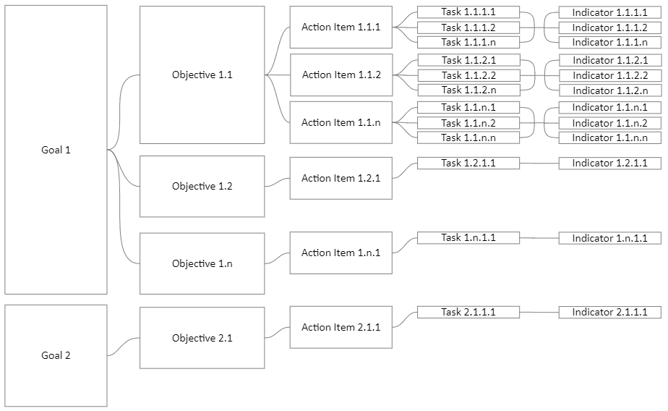
Strategic Plan Basic Structure
The guidance in these slides focuses on action item reporting

Slide 6
How to Open the Strategic Plan Dashboard

Slide 7
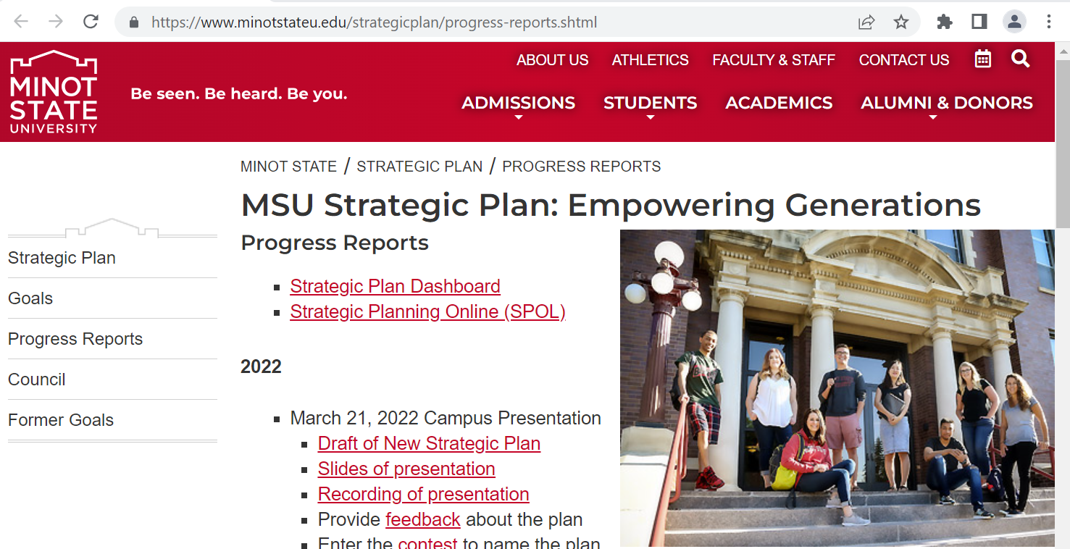
Go to the Strategic Plan Progress Reports page.
https://www.minotstateu.edu/strategicplan/progress-reports.shtml

Slide 8
Click Strategic Plan Dashboard

Slide 9
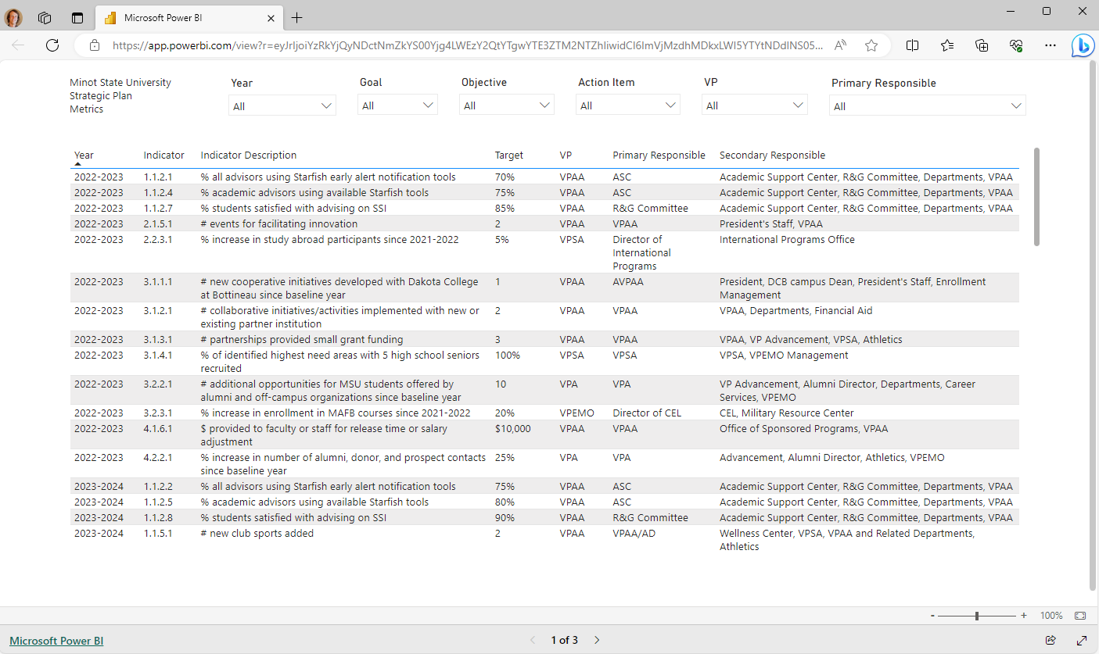
The Strategic Plan Dashboard displays

Slide 10
How to Log In to SPOL

Slide 11
Go to the Strategic Plan Progress Reports page.
https://www.minotstateu.edu/strategicplan/progress-reports.shtml

Slide 12
Click Strategic Planning Online (SPOL)

Slide 13
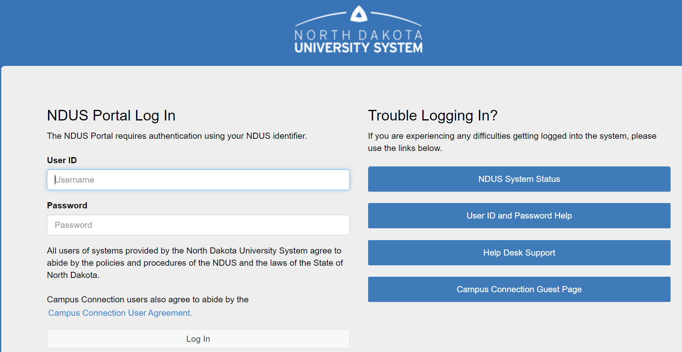
Log In with your NDUS User ID and Password

Slide 14
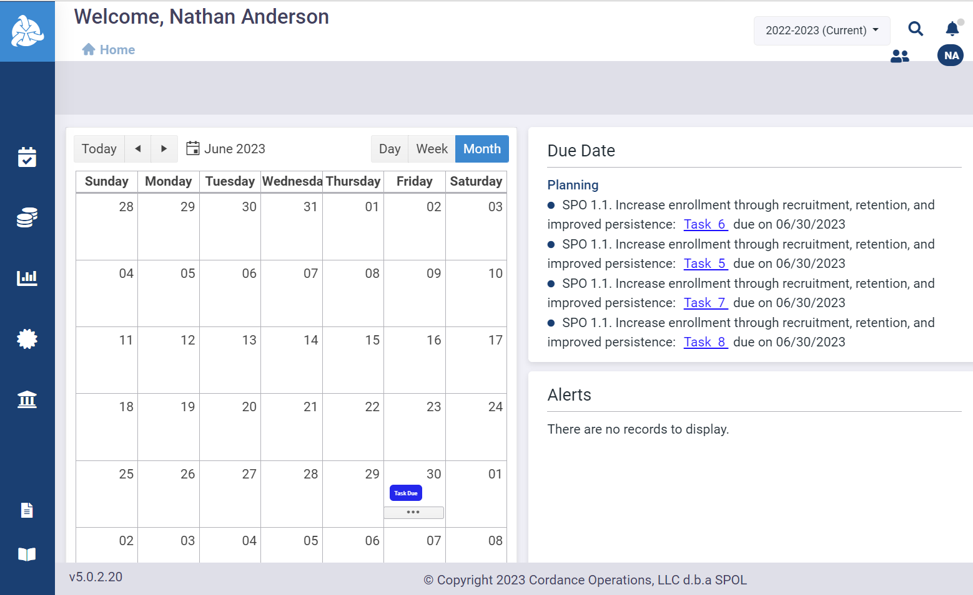
The SPOL Home page displays

Slide 15
Identify Action Items That Require Reporting

Slide 16
Open the Strategic Plan Dashboard

Slide 17
Click the right arrow toward to bottom middle of the dashboard to go to Page 2 (Strategic Plan Action Items)

Slide 18
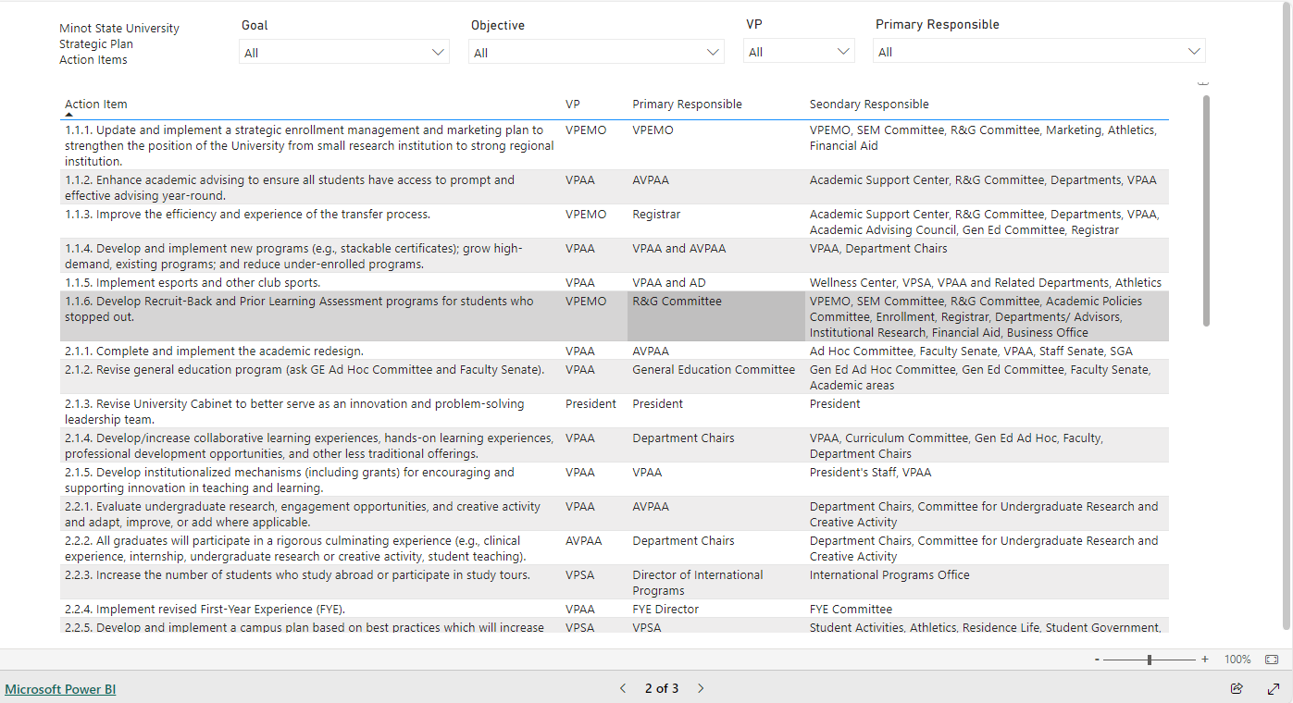
Page 2 (Strategic Plan Action Items) displays

Slide 19
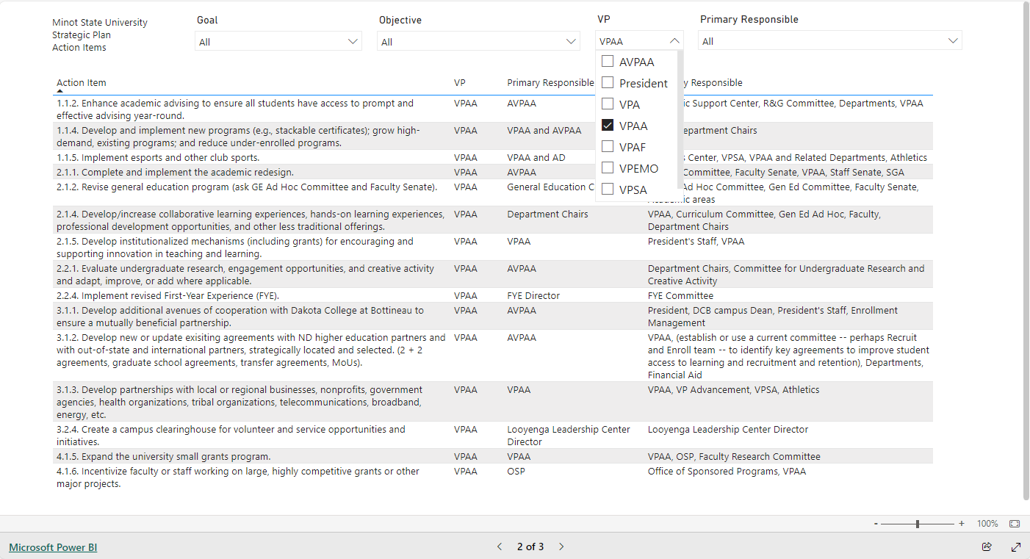
Select your role from the VP dropdown menu

Slide 20
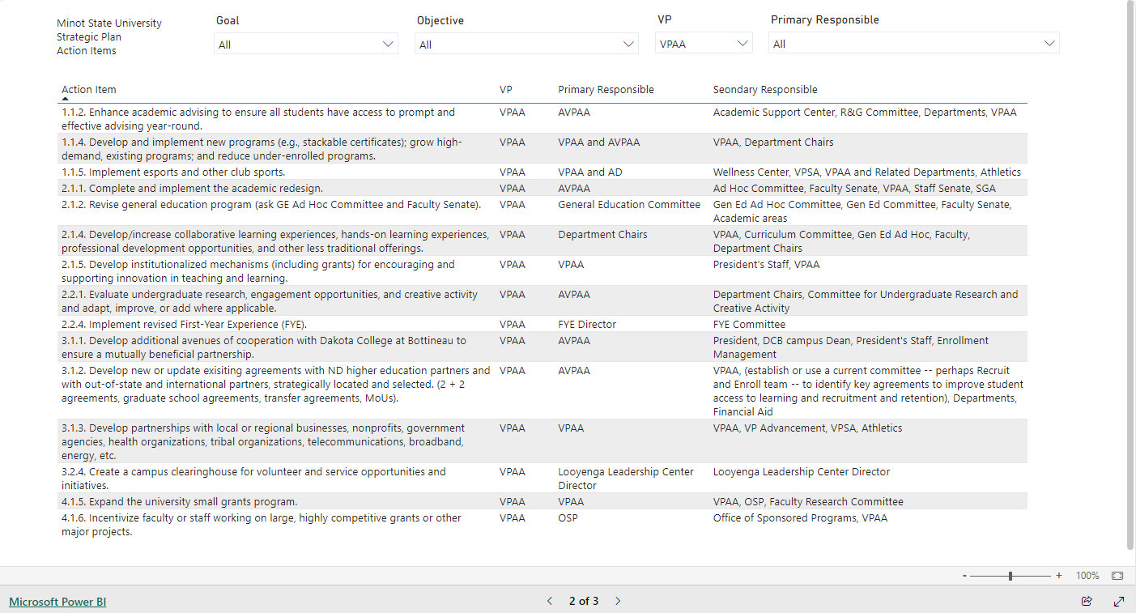
The action items for you to report on appear in the Action Item column.

Slide 21
Translate Strategic Plan Terminology to SPOL Planning Module Terminology

Slide 22
Strategic Plan Terminology​ | SPOL Planning Module Terminology​
Goal | Goal
Objective | Objective
Action Item | Task
Task | --

Slide 23
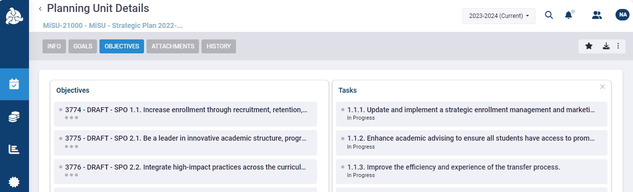
An Action Item in the strategic plan dashboard represents a Task in the SPOL Planning module.

Slide 24
Update the Implementation Status of an Action Item

Slide 25
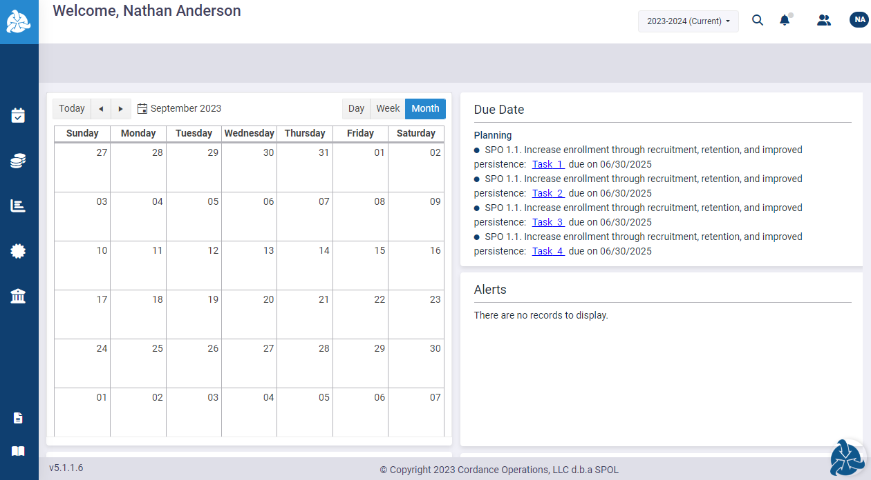
Open SPOL

Slide 26
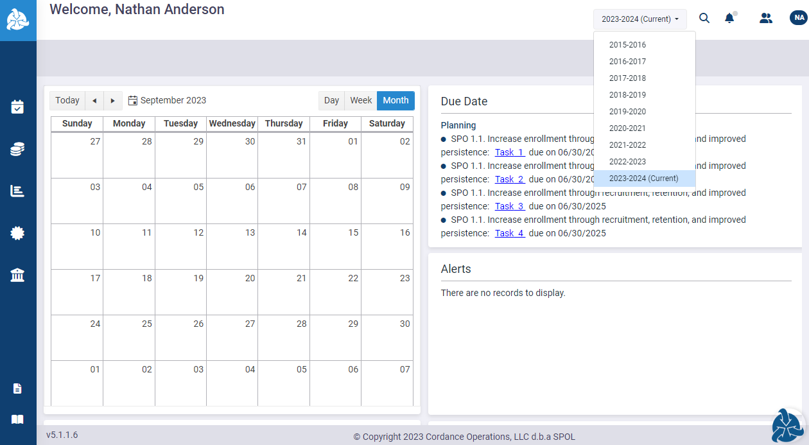
Select the desired year from the planning year dropdown menu in the upper right corner

Slide 27
Click the Planning icon in the left sidebar

Slide 28
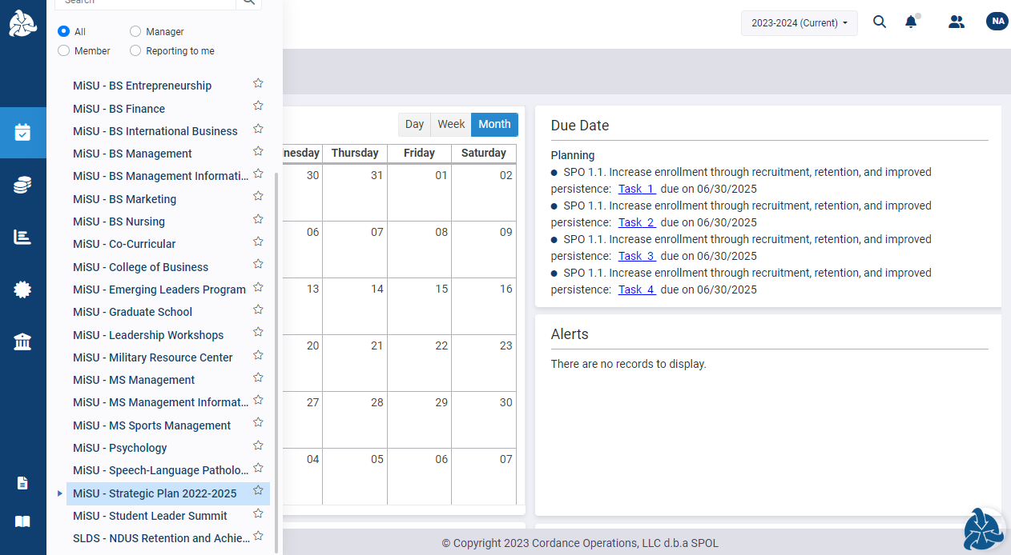
Click MiSU – Strategic Plan 2022-2025 in the expanded sidebar

Slide 29
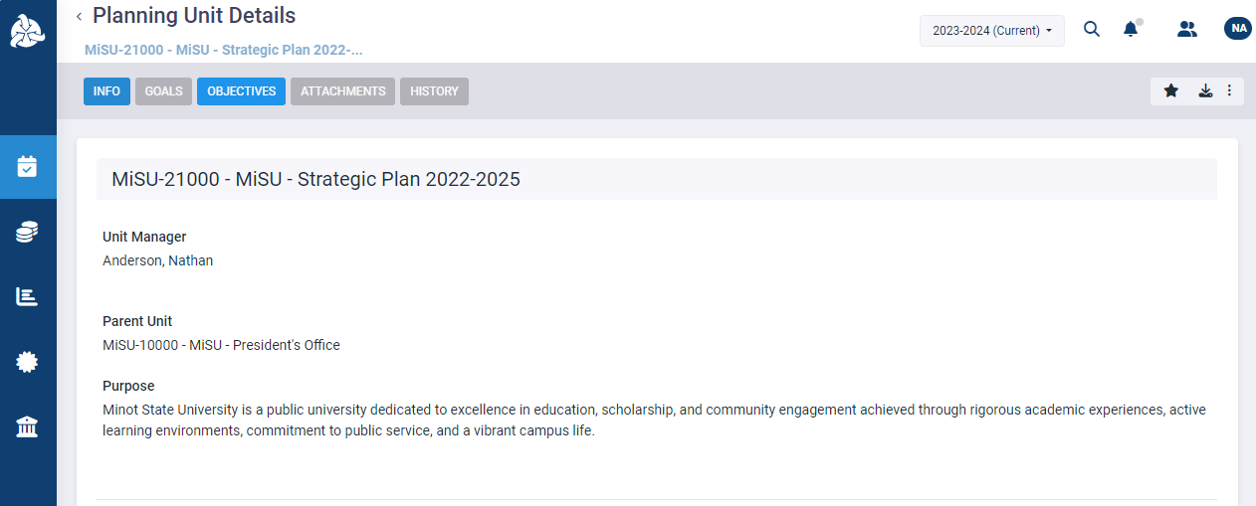
Click the Objectives tab

Slide 30
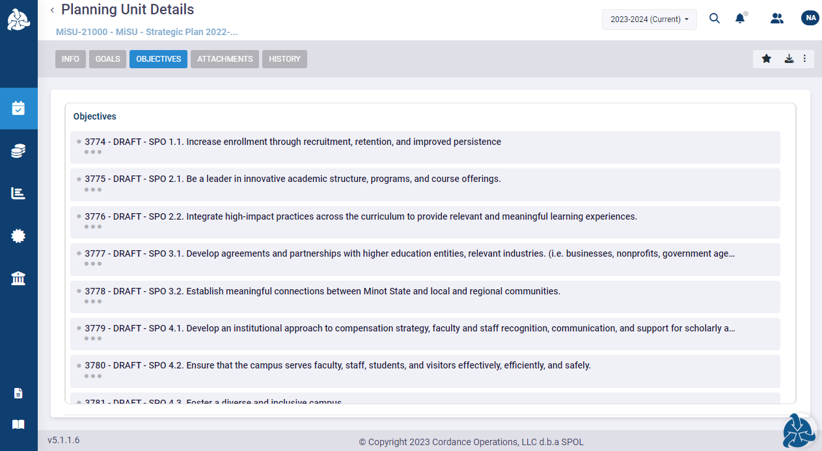
Click the Objective with the action item to be reported on

Slide 31
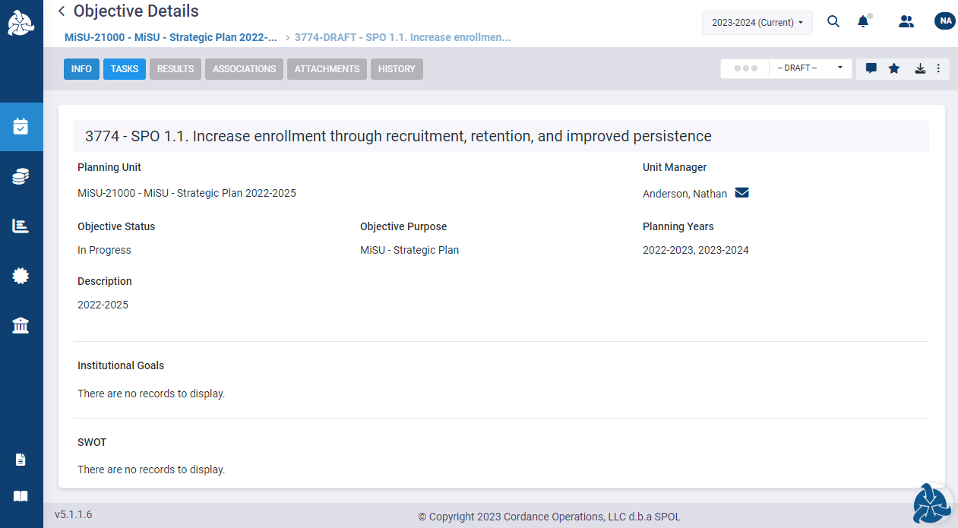
Click the Tasks tab

Slide 32
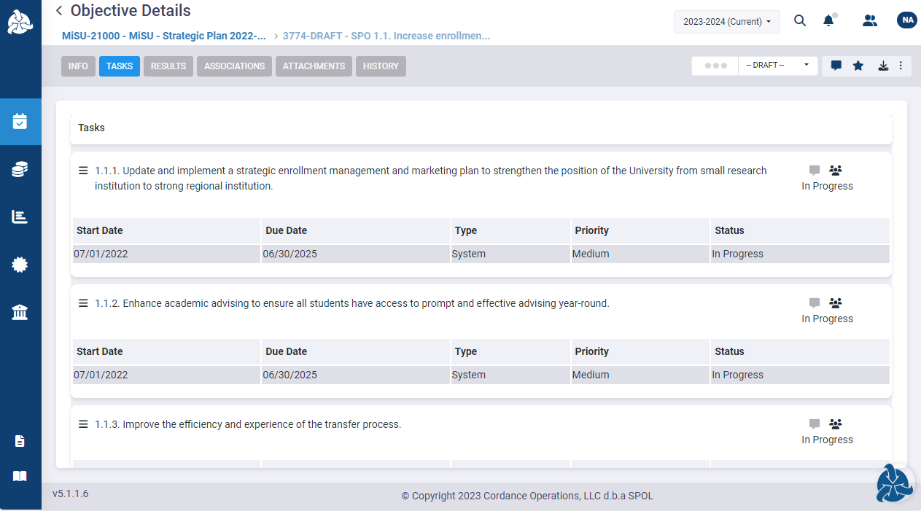
Scroll vertically through the tasks to locate the task (i.e., action item) to be reported on

Slide 33
The Task number and description in SPOL are the same as the Action Item number and description on the Strategic Plan dashboard

Slide 34
Click the task number or description to open the Task Details pane

Slide 35
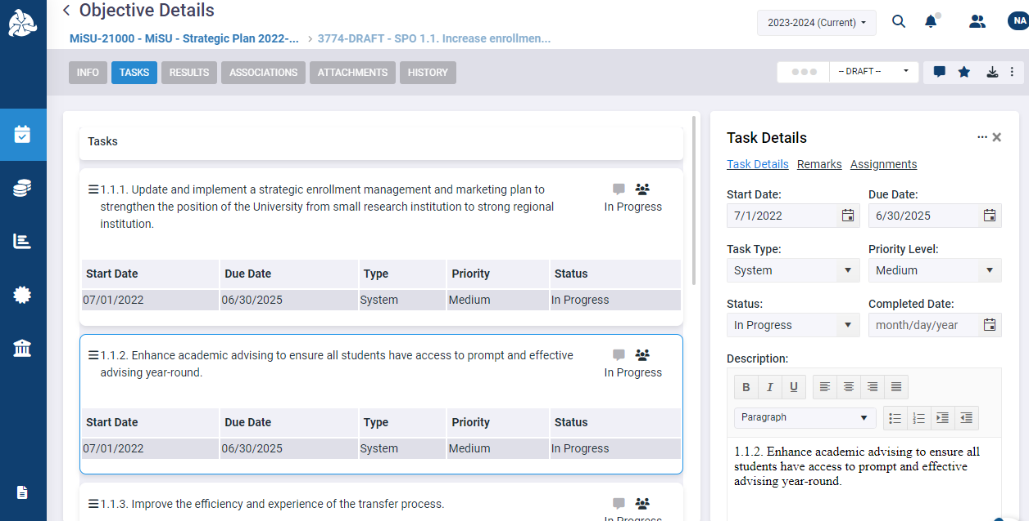
The Task Details pane displays

Slide 36
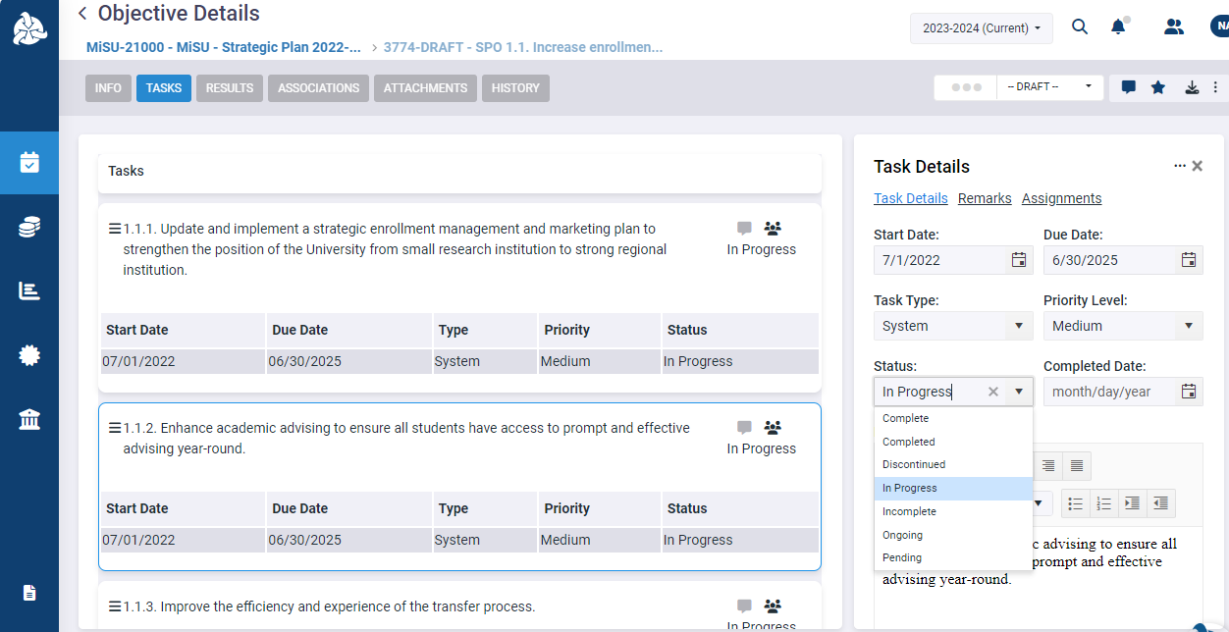
Select the current implementation status of the task from the Status dropdown menu

Slide 37
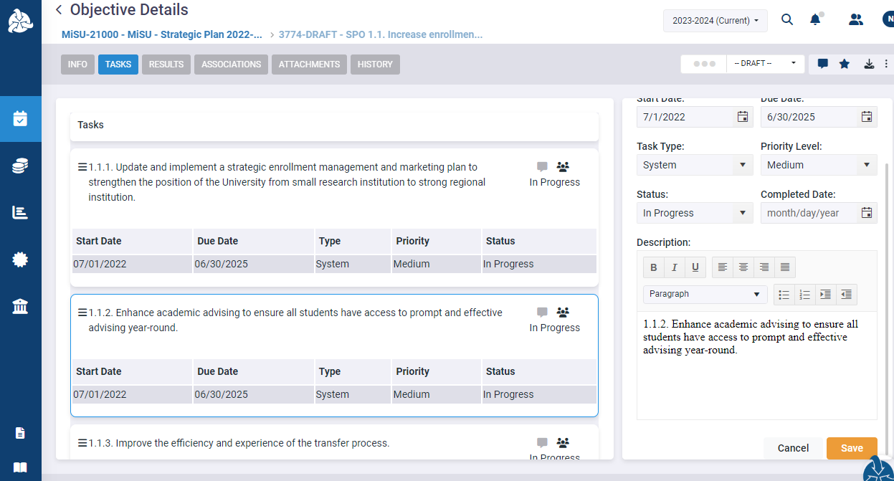
Scroll to the bottom of the Task Details pane. Click Save.

Slide 38
Write a Description of the Implementation Status of an Action Item

Slide 39
Click the comment icon adjacent to the task (i.e., action item) description to open the Remarks pane

Slide 40
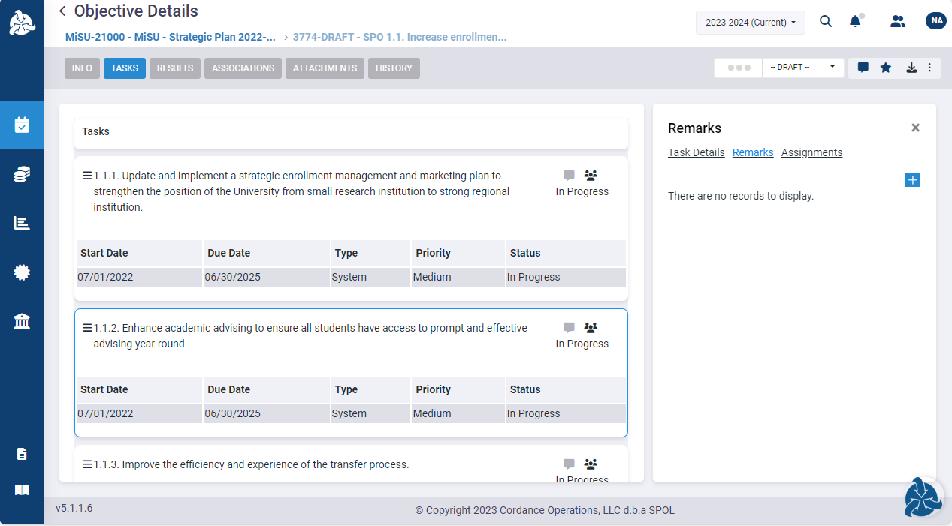
The Remarks pane displays

Slide 41
Click the plus (+) icon in the upper right corner

Slide 42
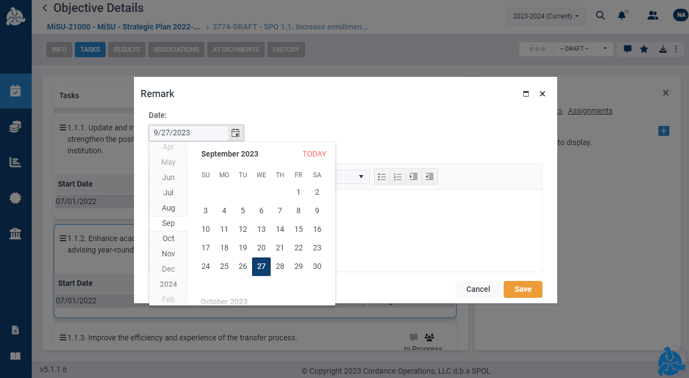
Select a date for the remark from the Date dropdown menu

Slide 43
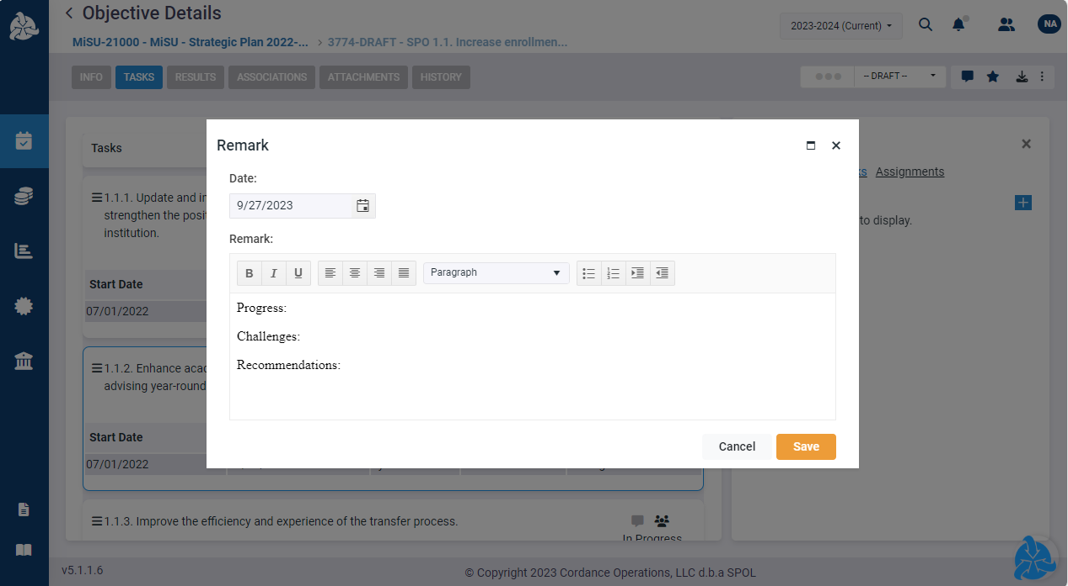
Write a description of the implementation status of the task. For example, comment on its progress, challenges, and/or recommendations that may be informed by its implementation status.

Slide 44
Click Save

Slide 45
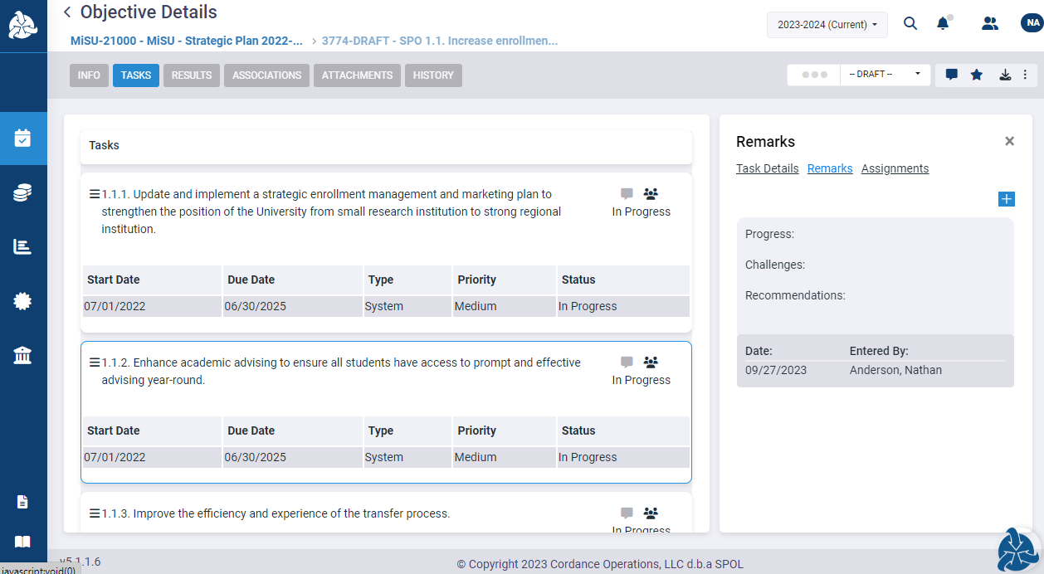
The description appears in the Remarks pane with its date and the name of the person who entered the remark

Slide 46
Click the X in the upper right corner to close the Remarks pane

Slide 47
Review of Objectives
Identify action items that require reporting
Translate strategic plan terminology to SPOL Planning module terminology
Update the implementation status of an action item in SPOL
Write a description of the implementation status of an action item in SPOL

Slide 48
Thank You!

